Slide 1
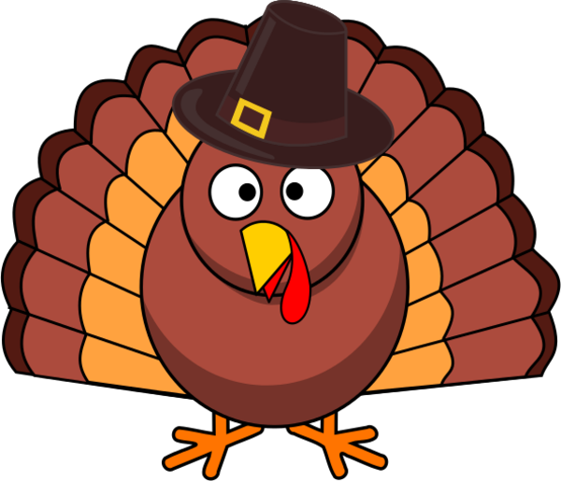
Ms. Frews
Fourth Grade
Nov 15th- Nov 21st
Hot Topics This Week!
Important Dates
Math- Multiplication Final test, factors and multiples, division
ELA- Tall Tales
Writing-Writing Process (POWER), Opinion Writing
Word Study – High Frequency Words on individual students reading level
Science –Rocks and Minerals
Social Studies- 3 Regions. Transitioning to Pirates
Nov 14th – Geography Bee 9:00am
Nov 15th- Pictures are DUE! – Send in pictures if you do not want to buy them or send in the money and order form if you do.
Nov 17th- Fall Festival
Nov 22-24 Thanksgiving Break
Homework: Weekly math and ELA has been assigned.
A Message from Ms. Frew
**Please have your child show you how to check their grades using their 1:1 issued lap tops.. Students have access to their grades and missing assignment information 24/7. Many students are missing assignments already for this 9 weeks.

