Slide 1
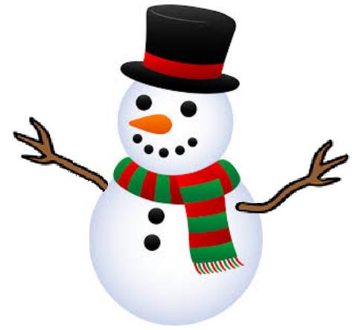
Ms. Frews
Fourth Grade
Dec 14th-Dec 20th
Hot Topics This Week!
Important Dates
Math- Review; Division/Prime/Composite/GCF/LCM
ELA- Poetry
Writing-Writing Process (POWER), Opinion Writing
Word Study – 4th Grade High Frequency Words Individualized by reading level
Science –Force and Motion
Social Studies- Pirates
(Holiday Crafts ☺ )
December 19th – Classroom party
December 20th – 4th Grade Holiday Rotations
December 20th – Sing Along at 1:00
December 20th – January 3rd Winter Break
Homework: Have students complete ANY and ALL missing work to return to me when they return from break to receive credit.
A Message from Ms. Frew
I hope everyone have a wonderful Winter Break!

